Slide 1
Supplying specialists powered by know-how
Wind Power
Infrastructure
Power-to-X

Slide 2
About A-LEAF
INTRODUCTION
A-LEAF is a consultancy firm that is specialized in supplying consultants and know-how for various industries, within Project and Quality Management.
We work exclusively with consultants that are specialized in working with On- & Offshore Wind, Infrastructure/Data Center and Renewable Energy projects.
ISO 9001, 14001 & 45001 Certified.

Slide 3
Our Values
INTRODUCTION
Transparency
Responsibility
Integrity
Transparency creates confidence - the foundation of every successful collaboration.
When we take on a project, it’s because we know we can deliver the required quality.
Integrity by staying honest to our clients and our employees.
Agile
Value creating
Quality
Our organization is very agile, ready to adjust at a moments notice.
Creating value by meeting requirements from both employers and employees.
It takes a specialist to supply a specialist – our specialists are powered by industry know-how.

Slide 4
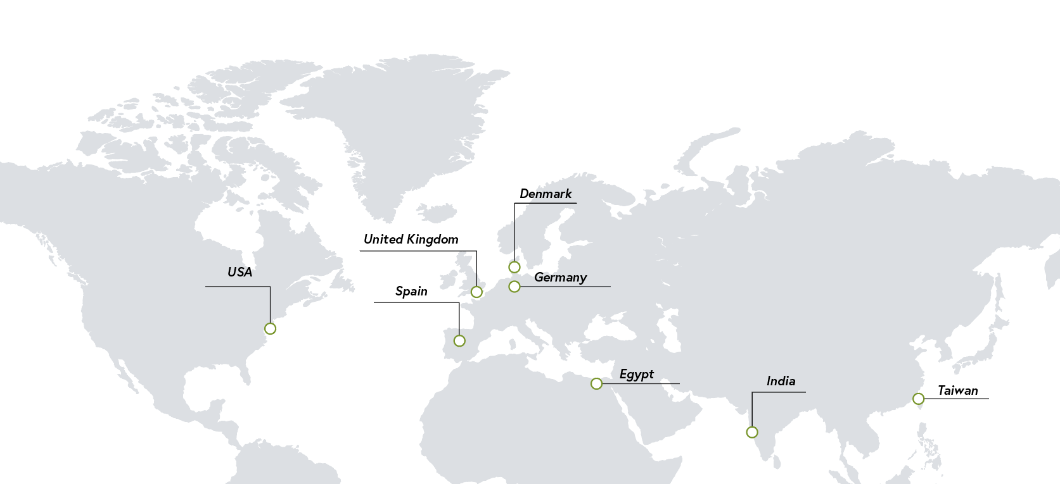
Locally Represented
INTRODUCTION
x3

Slide 5
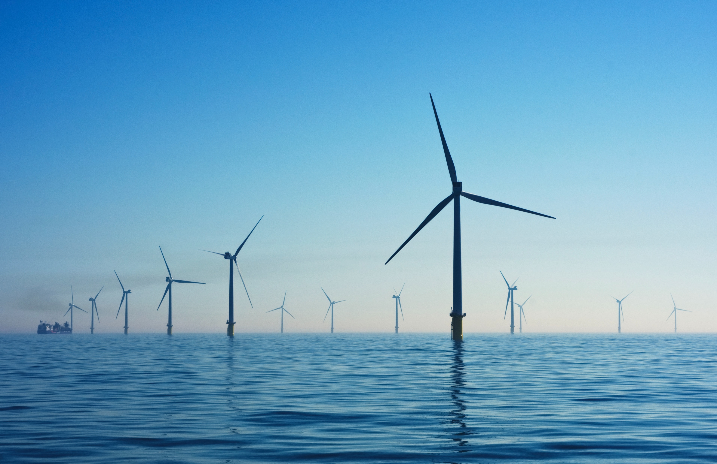
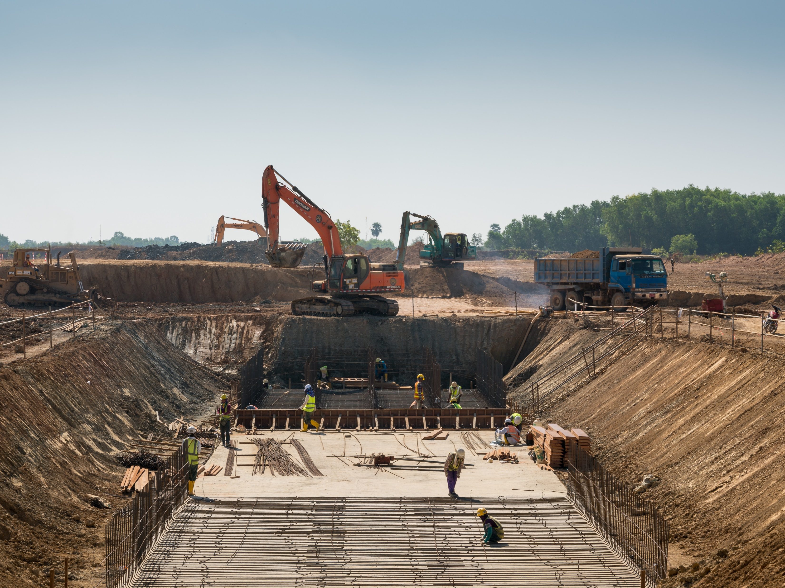
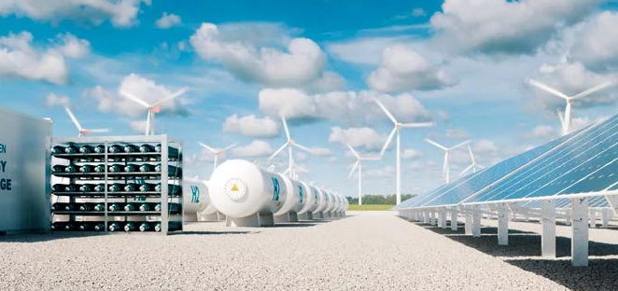
Our Areas of Business
SERVICE
On- & Offshore Wind
Infrastructure / Data Center
Power-to-X
30 years of experience within Heavy Steel and the On- & Offshore Wind Industry.
Solid track record for
Infrastructure Solutions.
Green energy initiatives, such as PtX, will be one of the areas we will focus on moving forward.

Slide 6
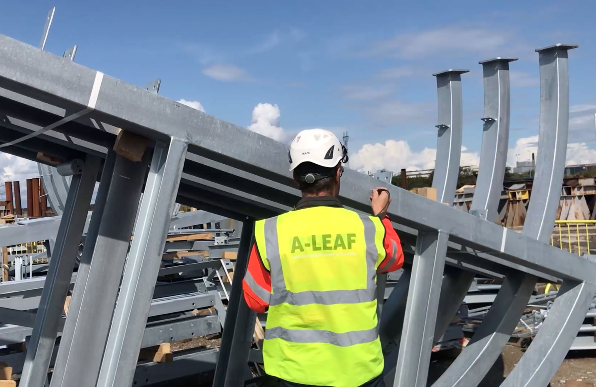
What We Do – QA, QC & HSE
SERVICE
QA, QC & HSE
Quality Assurance
Quality Control
HSE Management & Inspection
Documentation
Supplier Audits
Capacity audits

Slide 7
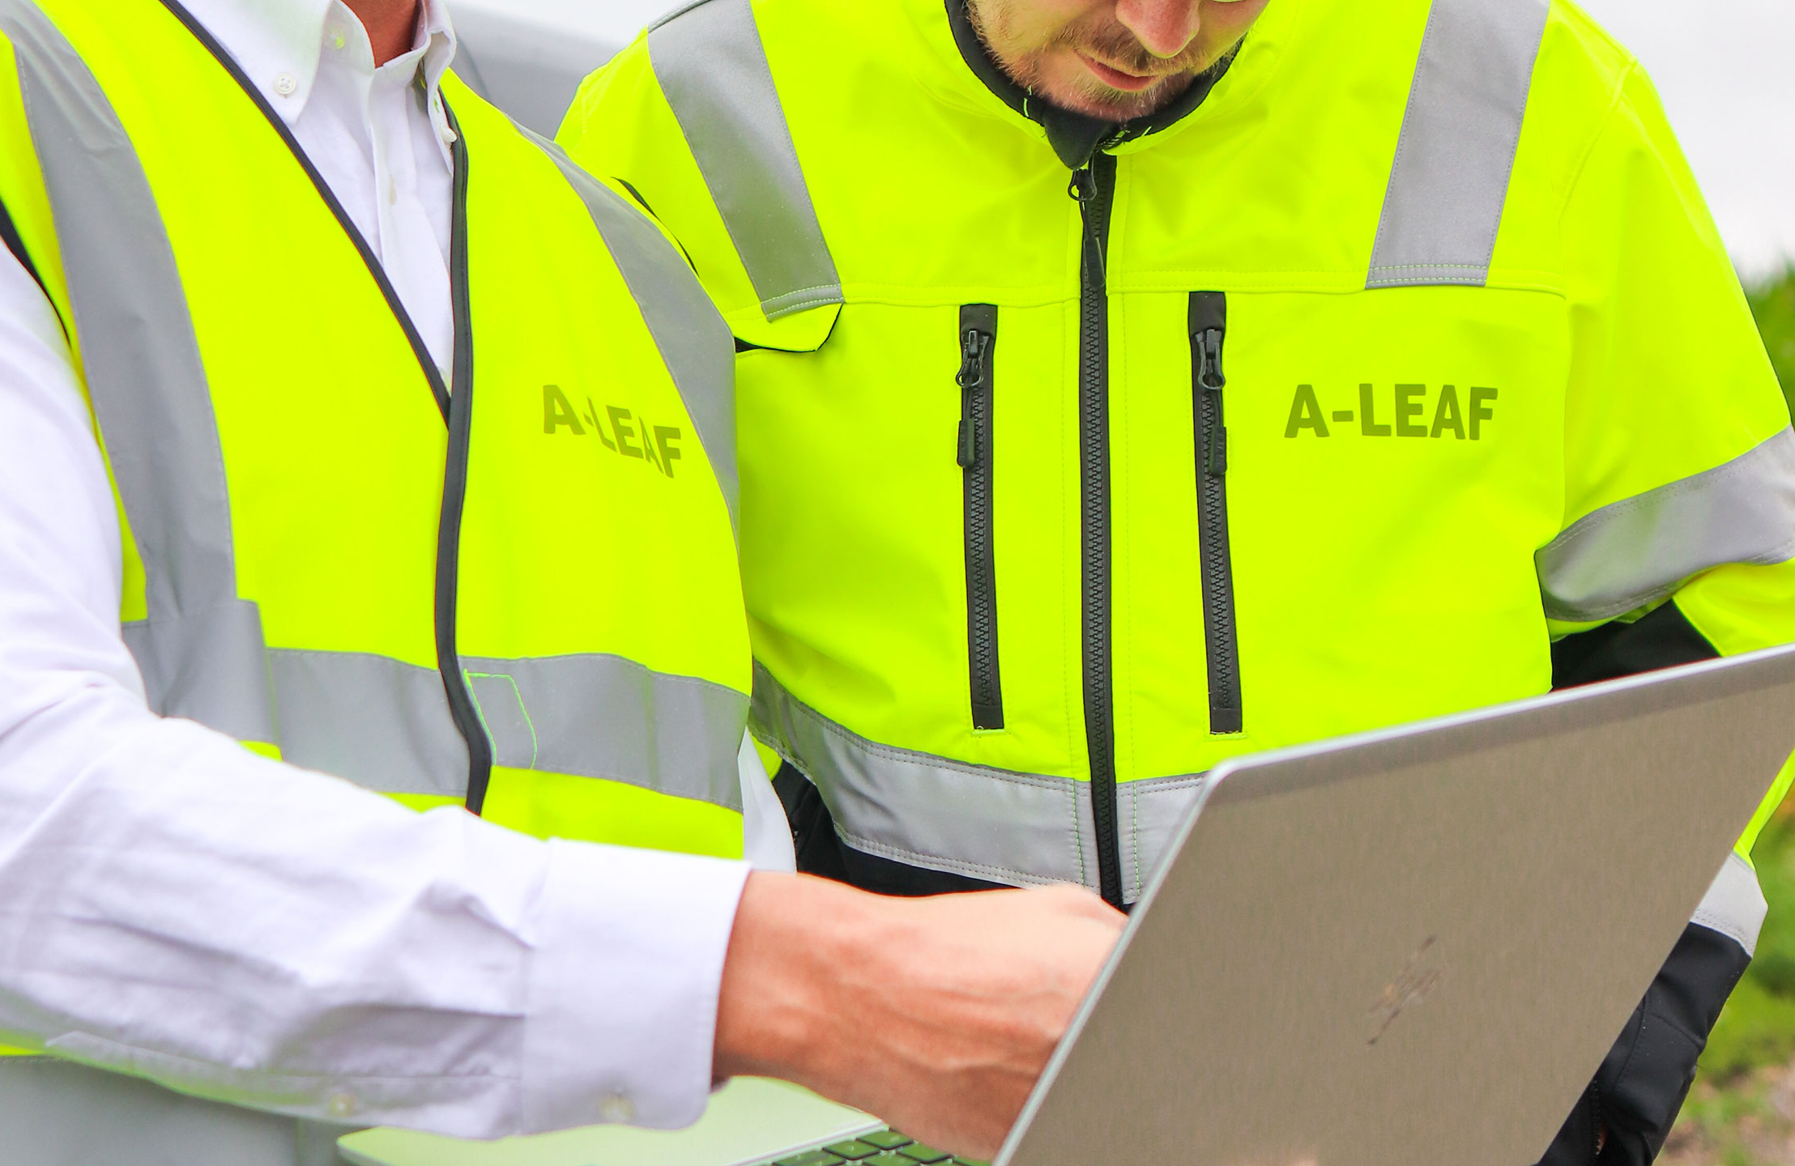
What We Do – Management
SERVICE
Management
Project Lead
Project Management
Fabrication Management
Contract Management
Sourcing Management
Site & Commissioning Management
Supply Chain Roadmap Management

Slide 8
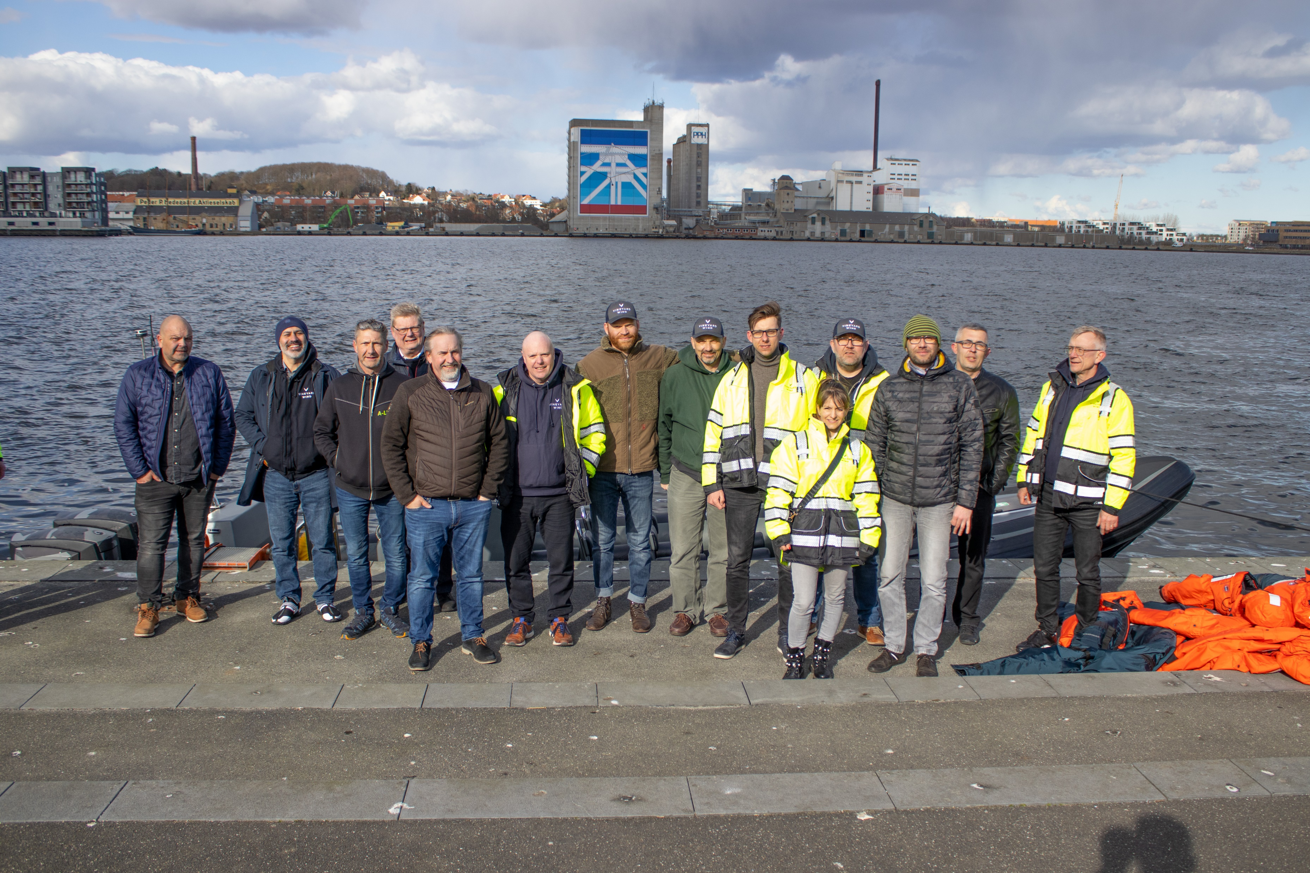
What We Do – Specialist Services
SERVICE
Specialist Services
Individual Specialist
Complete Project Organization.

Slide 9
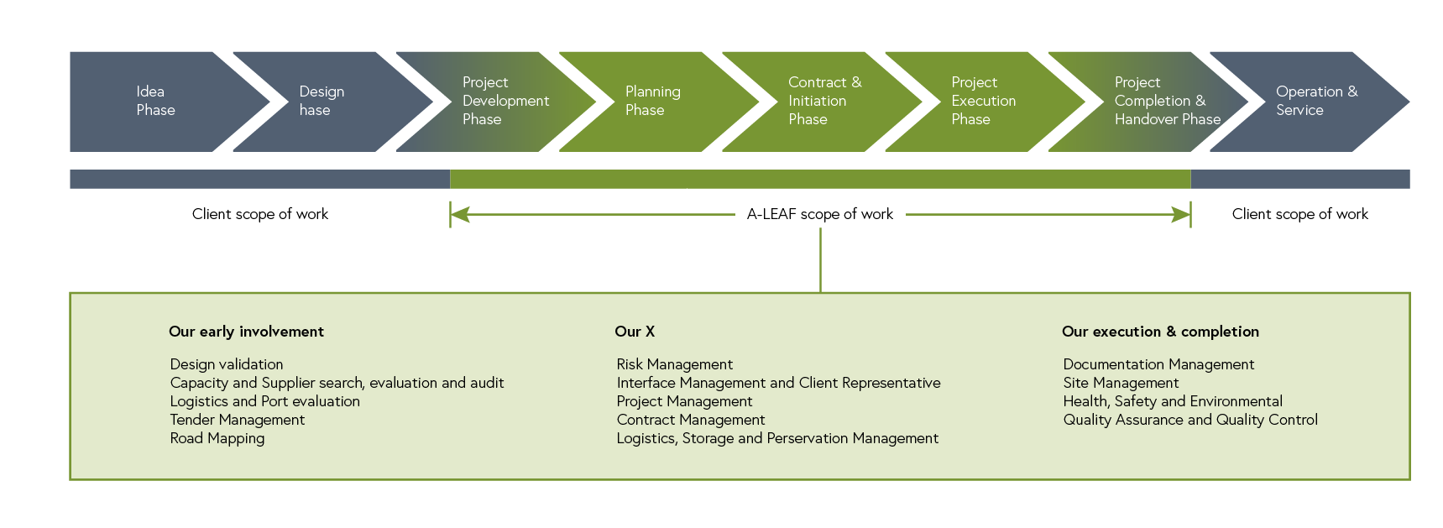
Our Scope of Work
SERVICE

Slide 10
On- & Offshore Wind
SERVICE
More than 30 years of solid experience within the Wind and Heavy Steel industry.

Slide 11
On- & Offshore Wind
SERVICE
Jackets,
TPs & MPs
WTG
OSS

Slide 12
Infrastructure & Data Center
SERVICE
Providing full-scale management solutions
towards Infrastructure & Data Center projects.

Slide 13
Infrastructure & Data Center
SERVICE
Gas Pipes
Bridges
Data Centers

Slide 14
What Our Clients Say
REFERENCES
BLADT INDUSTRIES
COWI
”When I have a request on
consultants, A-LEAF is always quick to provide us with several qualified candidates and they show a good understanding of what I need as a client.”
Jens Peter Andersen,
Product & Department Manager
“A-LEAF has a professional approach and possess highly capable expertise in QC of the final foundation production.”
Jan Rønberg,
Director Offshore Wind

Slide 15
Reference List – Part 1
REFERENCES
On- & Offshore Wind
Bladt Industries, Aalborg, Denmark - Senior Project Manager for Foundation Project.
SIF, Romania & Netherlands - Quality Assurance / Audit / 3-Party Inspection.
Bladt Industries, Aalborg, Denmark - Project Manager on production of TP’s for Hornsea & Hornsea Reef.
Hornsea 1, Ørsted, Denmark & UK - Senior Project & Electrical Manager, MP’s / TP’s.
Hornsea 1, Ørsted, Denmark & UK - Review on drawings and design and implementing QA/QC system in start up of new heavy steel facility for tower fabrication for onshore turbines.
Bladt Industries, Aalborg, Denmark - Quality Inspection on cables for Offshore Substation (OSS).
Hutchinson Engineering, UK and Denmark - Project Manager/ QA/QC Manager for tower fabrication for onshore turbines.
Hutchinson Engineering, Denmark and UK - Optimization of tower fabrication for onshore turbines in UK – higher/efficient and output.
Ørsted, Cuxhaven, Germany - Q-management on onshore production of 170 7MW Nacelles for Hornsea.
Bladt Industries, Finland - QA/QC inspection of TP for Beatrice project.
Bladt Industries, Lindø, Denmark - HSE Manager on Jacket foundation fabrication, Beatrice Project.
Bladt Industries, Latvia and Germany - QA/QC inspection of Jacket components for Beatrice Project.
Bladt Industries, Germany - QA/QC on Jacket legs, Beatrice project.
Ørsted, Lindø, Denmark - Senior QA, 8MW WTG, Borkhum Riffgrund 2 and Walney Extension 3.

Slide 16
Reference List – Part 2
REFERENCES
Swire Blue Ocean, Finland - QA Manager on Sea Fastening on Orca, app. 200t steel to be montaged on deck, Beatrice Project.
Bladt Industries, Lithuania, Latvia, Poland, Belgium and Germany - Senior Project Manager/Structural Designer/Design Eng./ for offshore jacket foundation, Beatrice project.
Vestas, Poland and Denmark - QA/QC on transportation equipment for WTG.
Bureau Veritas, Germany – 3rd party inspection TOC.
Infrastructure
MT-Hoejgaard / Skanska, Sweden & Spain - Hissingebron Bridge Project.
MT-Hoejgaard, Sweden - Senior Project Manager/ QA Manager on 200 t surfaces and steel constructions lift & swing steel Bridge of Södre Marieholm.
Grundfos, Denmark, China, and France - Project Manager on pumping systems.
COWI, Denmark - QA on foundation design, Formosa project.
Other
Ziton, UK – Port- & Site Management.
Ziton, UK – HSE Advisor offshore.
Ziton, Denmark - Port- & Site Management.
Cadeler, Denmark – Supervison/QA several mob/de-mob of Osprey and Orca.

Slide 17
Get In Touch
CONTACT
A-LEAF contact info
Mail: info@a-leaf.com
Web: www.a-leaf.com
Østergade 9, 1
8370, Hadsten
Denmark

